Slide 1

Contraceptive Pills and Mortality
Bellevue University
DSC530
LaChandra Ash
February 24, 2020

Slide 2
Abstract
The Study: Royal College of General Practitioners’ Oral Contraception RCGP study started in 1968.
Data Supplied: The data for the study was supplied by the practitioners whom participated in the study, and the National Health Service central services.
Amount: There were 1,200 general practices within the United Kingdom.
Subjects: There were 46, 112 women whom underwent the 39 years in the study.
Results: There were 1,747 women that died and never took the pills. There were 2,864 whom used the pills and died.
The objective of the project is to view the risk of mortality among women whom consume oral contraceptives, versus women who never used them.

Slide 3

Hypothesis
What was the association of women whom died and were taking the pills.?
Were the woman whom consumed the contraceptive pills already at risk of dying before taking the pill?
What are other factors that may have caused death while the women took the pills?

Slide 4
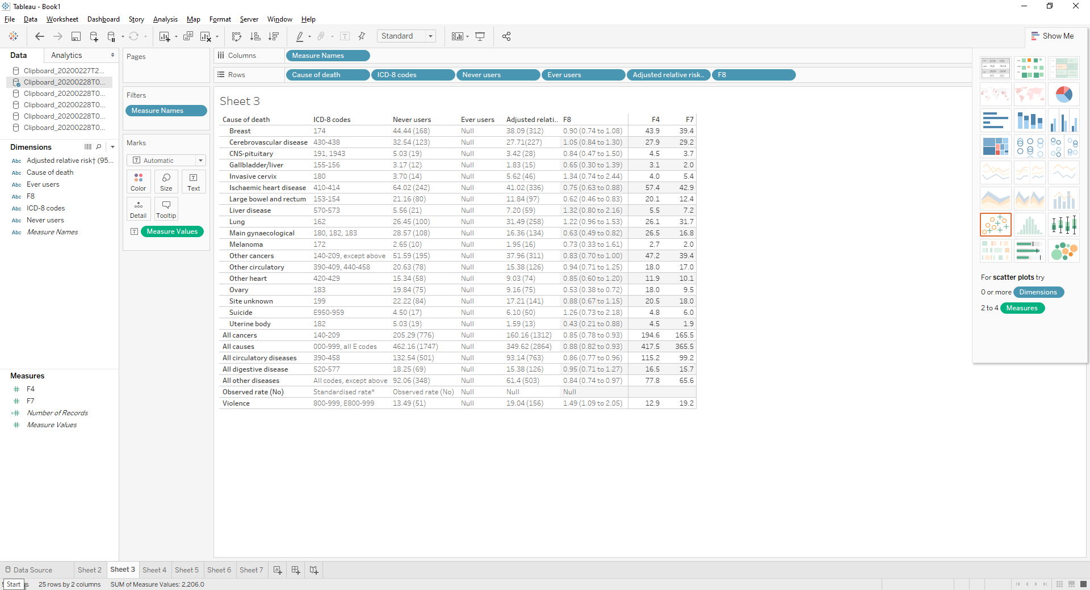
Dataset 2: Raw vs Clean
Cause of death | ICD-8 codes | Never users |  |  | Ever users |  | Adjusted relative risk† (95% CI)
 |  | Observed rate (No) | Standardised rate* |  | Observed rate (No) | Standardised rate*
All causes | 000-999, all E codes | 462.16 (1747) | 417.45 |  | 349.62 (2864) | 365.51 | 0.88 (0.82 to 0.93)
All cancers | 140-209 | 205.29 (776) | 194.55 |  | 160.16 (1312) | 165.45 | 0.85 (0.78 to 0.93)
Large bowel and rectum | 153-154 | 21.16 (80) | 20.05 |  | 11.84 (97) | 12.41 | 0.62 (0.46 to 0.83)
Gallbladder/liver | 155-156 | 3.17 (12) | 3.12 |  | 1.83 (15) | 2.03 | 0.65 (0.30 to 1.39)
Lung | 162 | 26.45 (100) | 26.08 |  | 31.49 (258) | 31.70 | 1.22 (0.96 to 1.53)
Melanoma | 172 | 2.65 (10) | 2.67 |  | 1.95 (16) | 1.95 | 0.73 (0.33 to 1.61)
Breast | 174 | 44.44 (168) | 43.91 |  | 38.09 (312) | 39.41 | 0.90 (0.74 to 1.08)
Invasive cervix | 180 | 3.70 (14) | 4.02 |  | 5.62 (46) | 5.38 | 1.34 (0.74 to 2.44)
Uterine body | 182 | 5.03 (19) | 4.47 |  | 1.59 (13) | 1.94 | 0.43 (0.21 to 0.88)
Ovary | 183 | 19.84 (75) | 18.04 |  | 9.16 (75) | 9.47 | 0.53 (0.38 to 0.72)
Main gynaecological | 180, 182, 183 | 28.57 (108) | 26.51 |  | 16.36 (134) | 16.80 | 0.63 (0.49 to 0.82)
CNS-pituitary | 191, 1943 | 5.03 (19) | 4.47 |  | 3.42 (28) | 3.74 | 0.84 (0.47 to 1.50)
Site unknown | 199 | 22.22 (84) | 20.50 |  | 17.21 (141) | 18.02 | 0.88 (0.67 to 1.15)
Other cancers | 140-209, except above | 51.59 (195) | 47.19 |  | 37.96 (311) | 39.39 | 0.83 (0.70 to 1.00)
All circulatory diseases | 390-458 | 132.54 (501) | 115.18 |  | 93.14 (763) | 99.15 | 0.86 (0.77 to 0.96)
Ischaemic heart disease | 410-414 | 64.02 (242) | 57.41 |  | 41.02 (336) | 42.85 | 0.75 (0.63 to 0.88)
Other heart | 420-429 | 15.34 (58) | 11.90 |  | 9.03 (74) | 10.12 | 0.85 (0.60 to 1.20)
Cerebrovascular disease | 430-438 | 32.54 (123) | 27.86 |  | 27.71(227) | 29.19 | 1.05 (0.84 to 1.30)
Other circulatory | 390-409, 440-458 | 20.63 (78) | 18.02 |  | 15.38 (126) | 16.98 | 0.94 (0.71 to 1.25)
All digestive disease | 520-577 | 18.25 (69) | 16.53 |  | 15.38 (126) | 15.67 | 0.95 (0.71 to 1.27)
Liver disease | 570-573 | 5.56 (21) | 5.48 |  | 7.20 (59) | 7.20 | 1.32 (0.80 to 2.16)
Violence | 800-999, E800-999 | 13.49 (51) | 12.86 |  | 19.04 (156) | 19.20 | 1.49 (1.09 to 2.05)
Suicide | E950-959 | 4.50 (17) | 4.79 |  | 6.10 (50) | 6.03 | 1.26 (0.73 to 2.18)
All other diseases | All codes, except above | 92.06 (348) | 77.80 |  | 61.4 (503) | 65.59 | 0.84 (0.74 to 0.97)

Slide 5
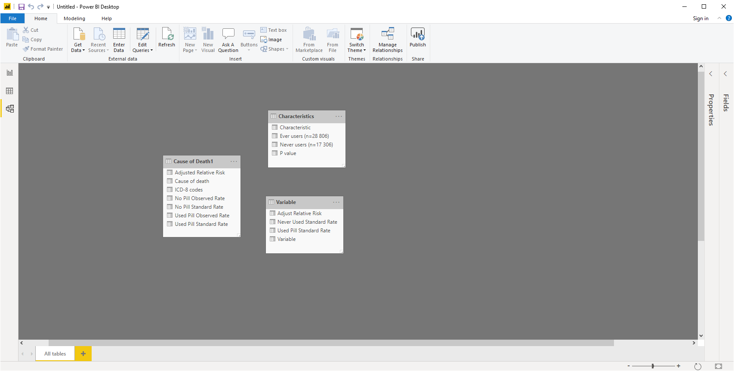
Datasets Relationship Model

Slide 6
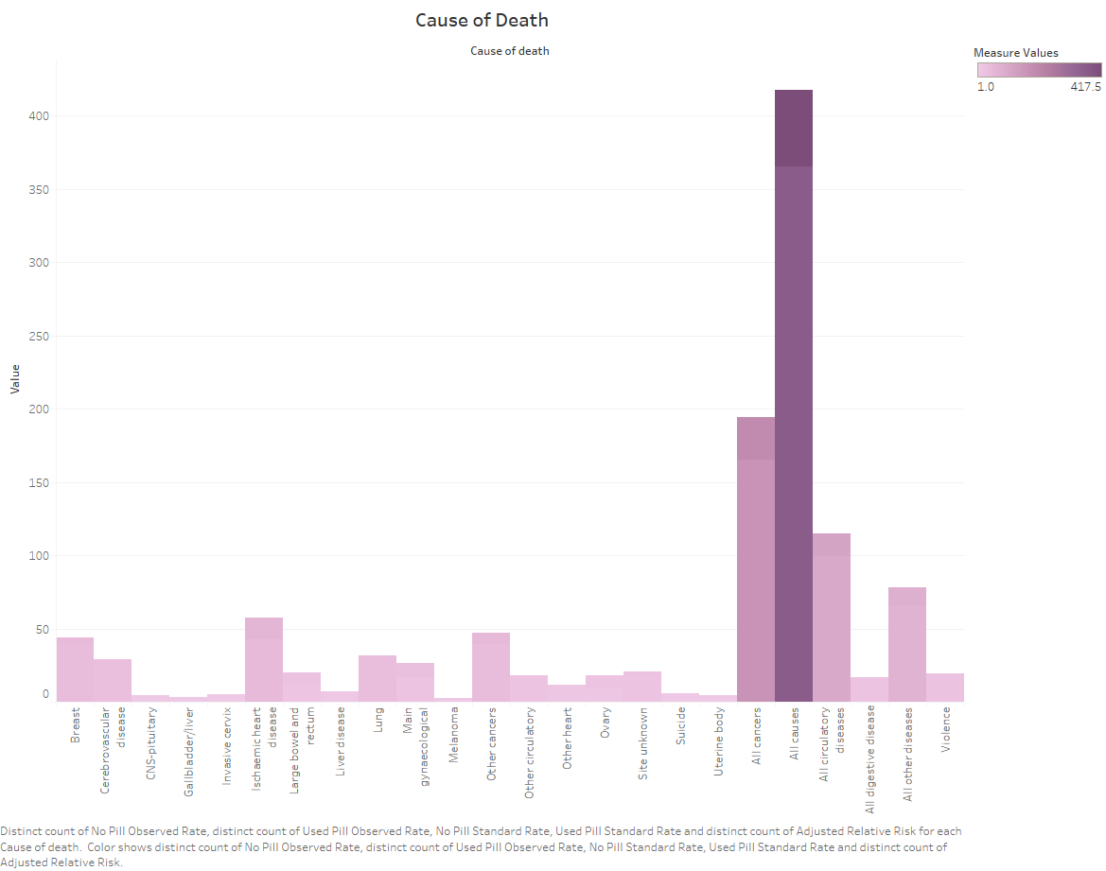
Causes of Death
The Cause of Death Histogram resulted in:
The top three causes of the death according to the histogram were any kinds of causes, cancers, and air circulatory issues.
The subjects may have contracted the cancer or other causes of death possibly before or during the study.
Women are still at risk of death for taking the pills. Women should find better alternatives to control birth.

Slide 7
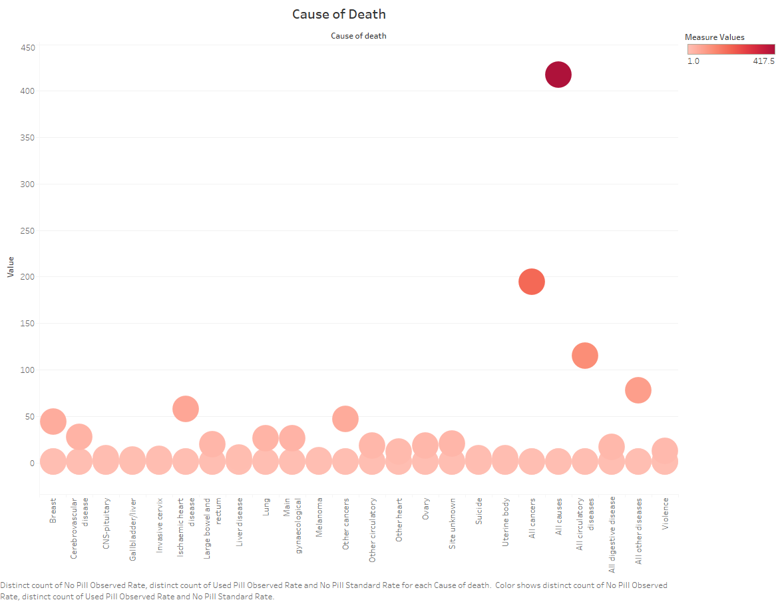
Scatter Plot 1
The scatter plot showed some outliers in the dataset.
The possible deaths were plotted on the x- axis and the measurements of the subjects whom used the pills.

Slide 8
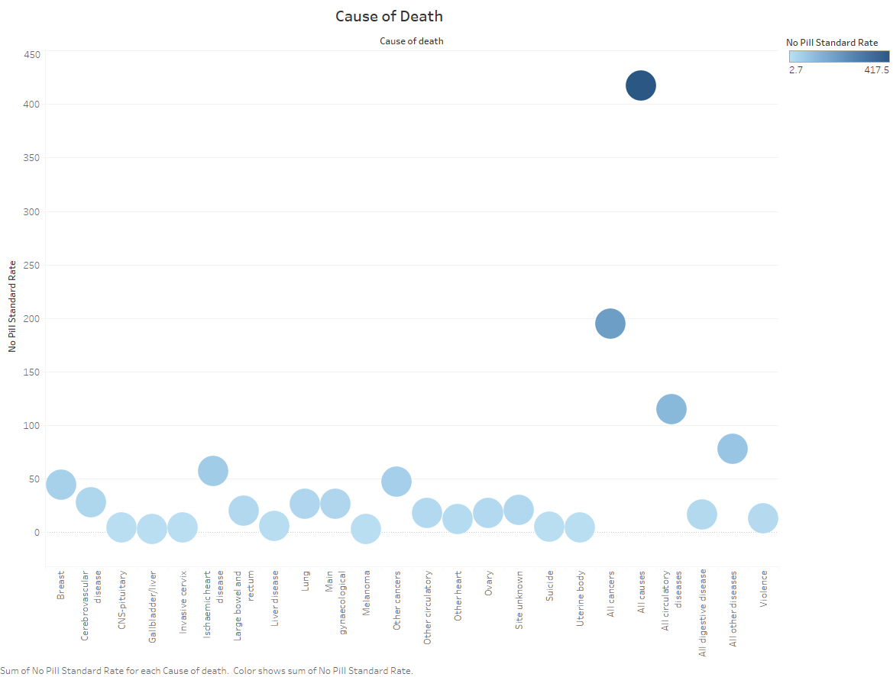
Scatter Plot 2
The scatter plot displayed the causes of death on the x- axis.
The y-axis contained the subjects that never used contraceptive pills.
A few outliers were dually noted.

